Slide 1
Chapter 7 – Architecture Design
Anh Nguyen-Duc
Tho Quan-Thanh
WEEK 7

Slide 2
Topics covered
Architectural design decisions
Architectural views
Architectural patterns
Application architectures

Slide 3
Software architecture
Describes how the system is organized as a set of communicating components
Architecture?
"Architecture" can mean: (http://en.wikipedia.org/wiki/Architecture)
A general term to describe buildings and other physical structures.
The art and science of designing buildings and (some) non-building structures.
The style of design and method of construction of buildings and other physical structures.
…

Slide 4
Architectural design
Concerned with:
how a software system should be organized and designing the overall structure of that system.
“build-a-house” metaphor: front end, back end, etc
“gardening” metaphor: refactoring, maintenance, etc
The critical link between design and requirements engineering
as it identifies the main structural components in a system and the relationships between them.
Agile?
An early stage: design an overall systems architecture.
Refactoring the system architecture is usually expensive
Notes:
Architectural design is concerned with understanding how a software system should be organized and designing the overall structure of that system.
There is a reason why we call it software architecture. Building software has a lot in common with the construction process of a house — but also quite some differences.
Frontend vs. Backend. The most typical analogy is comparing the difference between frontend and backend with a house. Think of the frontend as all the components of the house that are visible, such as the walls, windows, doors, roof, floors, etc. These components have styling properties such as size, color, material, and so on.
On the other hand, there are functional components in the house such as electrical wires and water pipes that are (usually) not visible to the user. However, these components are essentials for the house to work. This is what we can refer to as the backend of the house.
Architectural design is the critical link between design and requirements engineering, as it identifies the main structural components in a system and the relationships between them.
The output of the architectural design process is an architectural model that describes how the system is organized as a set of communicating components.

Slide 5
The architecture of a packing robot control system
Notes:
This is an abstract model of the architecture for a packing robot system that shows the components that have to be developed.
This robotic system can pack different kinds of object.
It uses a vision component to pick out objects on a conveyor, identify the type of object, and select the right kind of packaging.
The system then moves objects from the delivery conveyor to be packaged.
It places packaged objects on another conveyor.
The architectural model shows these components and the links between them.

Slide 6
Architectural abstraction
Architecture in the small
is concerned with the architecture of individual programs.
Architecture in the large
is concerned with the architecture of complex enterprise systems that include other systems, programs, and program components.
Software architecture is important because it affects the performance, robustness, distributability, and maintainability of a system.
Func. reqs.: individual components
Non-func. reqs: depend on the system architecture
Notes:
In practice, there is overlap between the processes of requirements engineering and architectural design.
Ideally, a system specification should not include any design information: unrealistic except for very small systems.
Architectural decomposition is usually necessary to structure and organize the specification.
The decomposition can be used to discuss the requirements and features of the system with stakeholders.
Two level of architectural abstraction:
Architecture in the small is concerned with the architecture of individual programs. At this level, we are concerned with the way that an individual program is decomposed into components.
Architecture in the large is concerned with the architecture of complex enterprise systems that include other systems, programs, and program components. These enterprise systems are distributed over different computers, which may be owned and managed by different companies.
Software architecture is important because it affects the performance, robustness, distributability, and maintainability of a system.
Individual components implement the functional system requirements.
The nonfunctional requirements depend on the system architecture
(In many systems, non-functional requirements are also influenced by individual components)

Slide 7
Advantages of explicit architecture
Stakeholder communication
Architecture may be used as a focus of discussion by system stakeholders.
System analysis
Means that analysis of whether the system can meet its non-functional requirements is possible.
Large-scale reuse
The architecture may be reusable across a range of systems
Product-line architectures may be developed.
Notes:
Advantages
1. Stakeholder communication:
The architecture is a high-level presentation of the system that may be used as a focus for discussion by a range of different stakeholders.
2. System analysis:
Making the system architecture explicit at an early stage in the system development requires some analysis. Architectural design decisions have a profound effect on whether or not the system can meet critical requirements such as performance, reliability, and maintainability.
3. Large-scale reuse:
A model of a system architecture is a compact, manageable description of how a system is organized and how the components interoperate. The system architecture is often the same for systems with similar requirements and so can support large-scale software reuse. It may be possible to develop product-line architectures where the same architecture is reused across a range of related systems.

Slide 8
Architectural representations
Mostly use: Simple, informal block diagrams showing entities and relationships
Problem: lack semantics
Box and line diagrams
Very abstract - do not show the nature of component relationships nor the externally visible properties of the sub-systems.
However, useful for communication with stakeholders and for project planning.
Notes:
Architectural representation
Simple, informal block diagrams showing entities and relationships are the most frequently used method for documenting software architectures.
But these have been criticised because they lack semantics, do not show the types of relationships between entities nor the visible properties of entities in the architecture.
Depends on the use of architectural models. The requirements for model semantics depends on how the models are used.

Slide 9
Use of architectural models
As a way of facilitating discussion about the system design
A high-level architectural view is useful for communication with system stakeholders and project planning
As a way of documenting an architecture that has been designed
to produce a complete system model that shows the different components in a system, their interfaces and their connections.
Notes:
Use of architectural models
As a way of facilitating discussion about the system design
A high-level architectural view of a system is useful for communication with system stakeholders and project planning because it is not cluttered with detail. Stakeholders can relate to it and understand an abstract view of the system. They can then discuss the system as a whole without being confused by detail.
As a way of documenting an architecture that has been designed
The aim here is to produce a complete system model that shows the different components in a system, their interfaces and their connections.

Slide 10
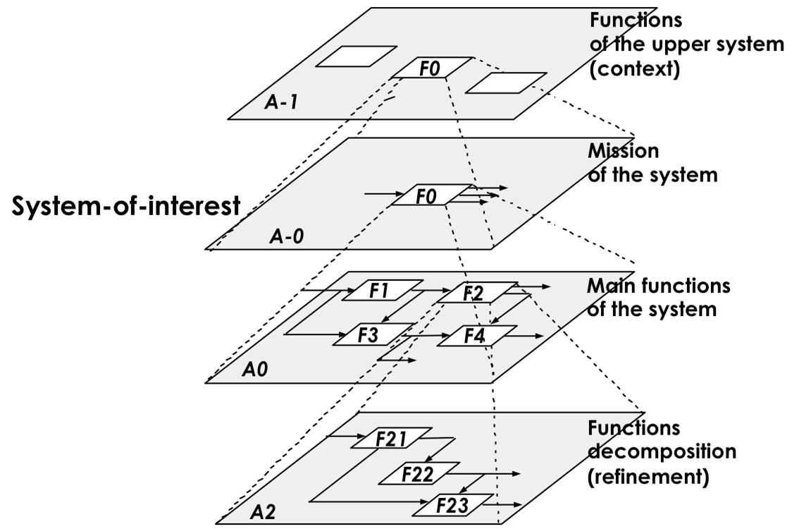
Architecture decomposition
Software systems:
complexity problem <= inter-relationship
Goals:
Maximizing cohesion
Minimizing coupling
Cohesion: degree of communication taken place among the module’s elements
Coupling: degree of communication among modules
Notes:
(Figure at http://sebokwiki.org/w/images/d/df/Decomposition_of_Functions_AF_071112%282%29.png)
One-way-to select an architecture
Develop a mental model of the application at a high level as if it were a small application
Example: a personal finance application “works by receiving money or paying out money, in any order, controlled through a user interface”.
2. Decompose into the required components
Look for high cohesion & low coupling
Example: the personal finance application is decomposed into Assets, Suppliers, & Interface.
3. Repeat this process for the new components.

Slide 11
Architectural design decisions

Slide 12
Architectural design decisions
Notes:
Architectural design is a creative process so the process differs depending on the type of system being developed.
However, a number of common decisions span all design processes and these decisions affect the non-functional characteristics of the system.
reuse
Systems in ehe same domain often have similar architectures that reflect domain concepts.
Application product lines are built around a core architecture with variants that satisfy particular customer requirements.
The architecture of a system may be designed around one of more architectural patterns or ‘styles’.
These capture the essence of an architecture and can be instantiated in different ways.

Slide 13
Architecture and system characteristics
Performance
Localize critical operations and minimize communications. Use large rather than fine-grain components.
Security
Use a layered architecture with critical assets in the inner layers.
Safety
Localize safety-critical features in a small number of sub-systems.
Availability
Include redundant components and mechanisms for fault tolerance.
Maintainability
Use fine-grain, replaceable components.
Notes:
Architecture and system characteristics
1. Performance
If performance is a critical requirement, the architecture should be designed to localize critical operations within a small number of components, with these components all deployed on the same computer rather than distributed across the network. This may mean using a few relatively large components rather than small, fine-grain components, which reduces the number of component communications.
2. Security
If security is a critical requirement, a layered structure for the architecture should be used, with the most critical assets protected in the innermost layers, with a high level of security validation applied to these layers.
3. Safety
If safety is a critical requirement, the architecture should be designed so that safety-related operations are all located in either a single component or in a small number of components. This reduces the costs and problems of safety validation and makes it possible to provide related protection systems that can safely shut down the system in the event of failure.
4. Availability
If availability is a critical requirement, the architecture should be designed to include redundant components so that it is possible to replace and update components without stopping the system.
5. Maintainability
If maintainability is a critical requirement, the system architecture should be designed using fine-grain, self-contained components that may readily be changed. Producers of data should be separated from consumers and shared data structures should be avoided.

Slide 14
Architectural views

Slide 15
Architectural views
What views or perspectives are useful when designing and documenting a system’s architecture?
What notations should be used for describing architectural models?
Each architectural model only shows one view or perspective of the system.
how a system is decomposed into modules
how the run-time processes interact
system components are distributed across a network
Notes:
Each architectural model only shows one view or perspective of the system.
It might show how a system is decomposed into modules, how the run-time processes interact or the different ways in which system components are distributed across a network. For both design and documentation, you usually need to present multiple views of the software architecture.

Slide 16
Architectural views
need to present multiple views of the software architecture.
Notes:
Each architectural model only shows one view or perspective of the system.
It might show how a system is decomposed into modules, how the run-time processes interact or the different ways in which system components are distributed across a network. For both design and documentation, you usually need to present multiple views of the software architecture.

Slide 17
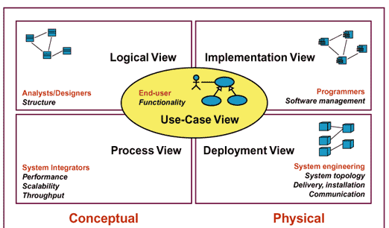
4 + 1 view model of software architecture
shows the key abstractions in the system as objects or classes.
shows how the software is decomposed for development.
shows how, at run-time, the system is composed of interacting processes.
shows the system hardware and how software components are distributed across the processors in the system.
Notes:
(Figure at https://sites.google.com/site/sureshdevang/software-development-process)
A logical view, which shows the key abstractions in the system as objects or object classes.
A process view, which shows how, at run-time, the system is composed of interacting processes.
A development view, which shows how the software is decomposed for development.
A physical view, which shows the system hardware and how software components are distributed across the processors in the system.
Related using use cases or scenarios (+1)

Slide 18
4 + 1 view model vs UML
Logical view:
Class diagram, Communication diagram, Sequence diagram
Process view:
Activity diagram
Development view:
Component diagram, Package diagram.
Physical view:
Deployment diagram
Scenarios (+1):
Use-case
Notes:
Class diagram
Sequence diagram
http://www.uml-diagrams.org/pluck-comments-uml-sequence-diagram-example.html
Activity diagram
http://www.uml-diagrams.org/google-sign-on-uml-activity-diagram-example.html
Package diagram
http://www.uml-diagrams.org/spring-hibernate-uml-package-diagram-example.html
Component diagram
http://www.uml-diagrams.org/examples/online-shopping-uml-component-diagram-example.html
Deployment diagram
http://www.uml-diagrams.org/deployment-diagrams.html
http://www.uml-diagrams.org/deployment-diagrams-examples.html

Slide 19
Architectural patterns

Slide 20
Architectural patterns
Patterns are a means of representing, sharing and reusing knowledge.
Patterns should include information about when they are and when the are not useful.
Patterns may be represented using tabular and graphical descriptions.
An architectural pattern is a stylized description of good design practice, which has been tried and tested in different environments.
Notes:
The idea of patterns: first published in 1995 (Gamma et al., 1995).
Many types of patterns:
patterns for organizational design
usability patterns
Interaction
configuration management
…

Slide 21
The Model-View-Controller (MVC) pattern
Name | MVC (Model-View-Controller)
Description | Separates presentation and interaction from the system data. The system is structured into three logical components that interact with each other. The Model component manages the system data and associated operations on that data. The View component defines and manages how the data is presented to the user. The Controller component manages user interaction (e.g., key presses, mouse clicks, etc.) and passes these interactions to the View and the Model.
Example | The next slide shows the architecture of a web-based application system organized using the MVC pattern.
When used | Used when there are multiple ways to view and interact with data. Also used when the future requirements for interaction and presentation of data are unknown.
Advantages | Allows the data to change independently of its representation and vice versa. Supports presentation of the same data in different ways with changes made in one representation shown in all of them.
Disadvantages | Can involve additional code and code complexity when the data model and interactions are simple.
Notes:
This pattern is the basis of interaction management in many web-based systems.

Slide 22
Conceptual view of the MVC and web-based MVC
Notes:
The conceptual view is the graphical model of the architecture (associated with the MVC pattern, in this case)
The other view shows the possible run-time architecture when this pattern is used for interaction management in a web-based system.

Slide 23
Read and apply the code In https://www.javatpoint.com/mvc-architecture-in-java to view all MCPs FROM the back officers’ view https://github.com/anhn/co3001_design_lecture

Slide 24
The Layered architecture pattern
Name | Layered architecture
Description | Organizes the system into layers with related functionality associated with each layer. A layer provides services to the layer above it so the lowest-level layers represent core services that are likely to be used throughout the system. See Figure 6.6.
Example | A layered model of a system for sharing copyright documents held in different libraries
When used | Used when building new facilities on top of existing systems; when the development is spread across several teams with each team responsibility for a layer of functionality; when there is a requirement for multi-level security.
Advantages | Allows replacement of entire layers so long as the interface is maintained. Redundant facilities (e.g., authentication) can be provided in each layer to increase the dependability of the system.
Disadvantages | In practice, providing a clean separation between layers is often difficult and a high-level layer may have to interact directly with lower-level layers rather than through the layer immediately below it. Performance can be a problem because of multiple levels of interpretation of a service request as it is processed at each layer.
Notes:
Used to model the interfacing of sub-systems.
Organises the system into a set of layers (or abstract machines) each of which provide a set of services.
Supports the incremental development of sub-systems in different layers. When a layer interface changes, only the adjacent layer is affected.
However, often artificial to structure systems in this way.

Slide 25
A generic layered architecture
A generic layered architecture
The architecture of the iLearn system
Notes:
This is an example of a layered architecture with four layers.
The lowest layer includes system support software—typically database and operating system support.
The next layer is the application layer that includes the components concerned with the application functionality and utility components that are used by other application components.
The third layer is concerned with user interface management and providing user authentication and authorization.
The top layer providing user interface facilities.
A specific layer architecture for a library system called LIBSYS can be in 5 layers.
It allows controlled electronic access to copyright material from a group of university libraries.
This has a five-layer architecture, with the bottom layer being the individual databases in each library.

Slide 26
Repository architecture
Sub-systems must exchange data. This may be done in two ways:
Shared data is held in a central database or repository and may be accessed by all sub-systems;
Each sub-system maintains its own database and passes data explicitly to other sub-systems.
When large amounts of data are to be shared, the repository model of sharing is most commonly used a this is an efficient data sharing mechanism.

Slide 27
The Repository pattern
Name | Repository
Description | All data in a system is managed in a central repository that is accessible to all system components. Components do not interact directly, only through the repository.
Example | The next is an example of an IDE where the components use a repository of system design information. Each software tool generates information which is then available for use by other tools.
When used | You should use this pattern when you have a system in which large volumes of information are generated that has to be stored for a long time. You may also use it in data-driven systems where the inclusion of data in the repository triggers an action or tool.
Advantages | Components can be independent—they do not need to know of the existence of other components. Changes made by one component can be propagated to all components. All data can be managed consistently (e.g., backups done at the same time) as it is all in one place.
Disadvantages | The repository is a single point of failure so problems in the repository affect the whole system. May be inefficiencies in organizing all communication through the repository. Distributing the repository across several computers may be difficult.
Notes:
Repository architecture
Sub-systems must exchange data. This may be done in two ways:
Shared data is held in a central database or repository and may be accessed by all sub-systems;
Each sub-system maintains its own database and passes data explicitly to other sub-systems.
When large amounts of data are to be shared, the repository model of sharing is most commonly used a this is an efficient data sharing mechanism.

Slide 28
A repository architecture for an IDE
Notes:
This is an illustration of a situation in which a repository might be used.
This diagram shows an IDE that includes different tools to support model-driven development.
The repository in this case might be a version-controlled environment that keeps track of changes to software and allows rollback to earlier versions.
Discussion
This is an efficient way to share large amounts of data: No data transmission explicitly from one component to another.
Inevitably, this is a compromise between the specific needs of each tool and it may be difficult or impossible to integrate new components if their data models do not fit
the agreed schema.
In practice, it may be difficult to distribute the repository over a number of machines.

Slide 29
The Client–server pattern
Name | Client-server
Description | In a client–server architecture, the functionality of the system is organized into services, with each service delivered from a separate server. Clients are users of these services and access servers to make use of them.
Example | Figure in the next slide is an example of a film and video/DVD library organized as a client–server system.
When used | Used when data in a shared database has to be accessed from a range of locations. Because servers can be replicated, may also be used when the load on a system is variable.
Advantages | The principal advantage of this model is that servers can be distributed across a network. General functionality (e.g., a printing service) can be available to all clients and does not need to be implemented by all services.
Disadvantages | Each service is a single point of failure so susceptible to denial of service attacks or server failure. Performance may be unpredictable because it depends on the network as well as the system. May be management problems if servers are owned by different organizations.
Notes:
Distributed system model which shows how data and processing is distributed across a range of components.
Can be implemented on a single computer.
Set of stand-alone servers which provide specific services such as printing, data management, etc.
Set of clients which call on these services.
Network which allows clients to access servers.

Slide 30
A client–server architecture for a film library
Notes:
This model is a multi-user, web-based system for providing a film and photograph library.
In this system, several servers manage and display the different types of media.
Video frames need to be transmitted quickly and in synchrony but at relatively low resolution.
They may be compressed in a store, so the video server can handle video compression and decompression in different formats. Still pictures, however, must be maintained at a high resolution, so it is appropriate to maintain them on a separate server.

Slide 31
The pipe and filter pattern
Name | Pipe and filter
Description | The processing of the data in a system is organized so that each processing component (filter) is discrete and carries out one type of data transformation. The data flows (as in a pipe) from one component to another for processing.
Example | Figure in the next slide is an example of a pipe and filter system used for processing invoices.
When used | Commonly used in data processing applications (both batch- and transaction-based) where inputs are processed in separate stages to generate related outputs.
Advantages | Easy to understand and supports transformation reuse. Workflow style matches the structure of many business processes. Evolution by adding transformations is straightforward. Can be implemented as either a sequential or concurrent system.
Disadvantages | The format for data transfer has to be agreed upon between communicating transformations. Each transformation must parse its input and unparse its output to the agreed form. This increases system overhead and may mean that it is impossible to reuse functional transformations that use incompatible data structures.
Notes:
Functional transformations process their inputs to produce outputs.
May be referred to as a pipe and filter model (as in UNIX shell).
Variants of this approach are very common. When transformations are sequential, this is a batch sequential model which is extensively used in data processing systems.
Not really suitable for interactive systems.

Slide 32
An example of the pipe and filter architecture
Notes:
An example of this type of system architecture, used in a batch processing application.
An organization has issued invoices to customers.
Once a week, payments that have been made are reconciled with the invoices.
For those invoices that have been paid, a receipt is issued. For those invoices that have not been paid within the allowed payment time, a reminder is issued.

Slide 33
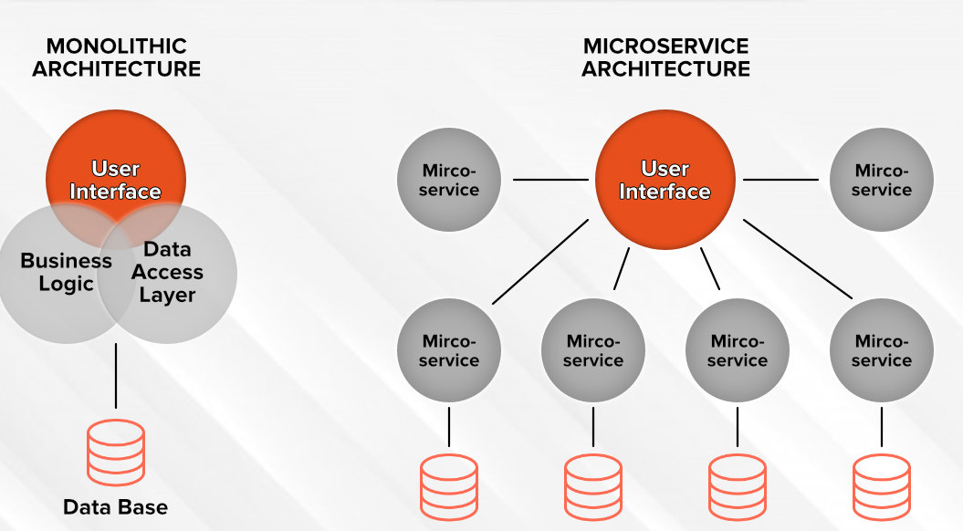

Slide 34
In-class activity
Microservice architecture vs. Monolithic architecture
Notes:
https://www.youtube.com/watch?v=3uHs2U8k40I

Slide 35
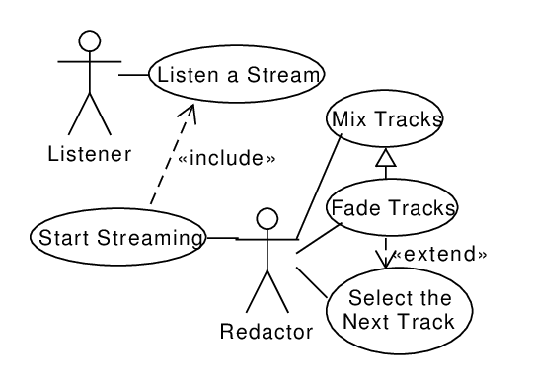
Architecture for a streaming platform
a streaming platform is an on-demand online entertainment source for TV shows, movies and other streaming media. For example, think of things like Hulu, Netflix, Amazon Prime Video, Vimeo, and Sundance Now.

Slide 36
Read about
Client-server pattern
Repository pattern
Message Broker pattern
MVC pattern
Pipe and filter pattern
Microservice vs. Monolithic architecture
Pros & cons

Slide 37
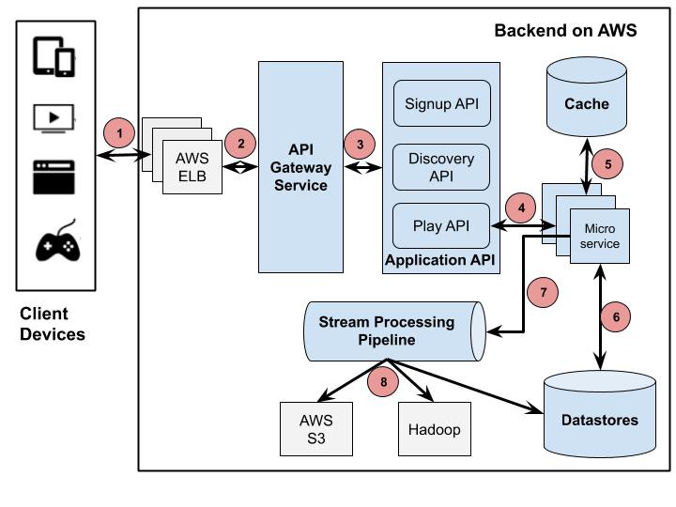

Slide 38
Monolithic architecture | Microservices architecture
Simple to develop and deploy | Complex and hard to develop and deploy
Interconnectivity | Autonomy
Code changes affect the entire system | Only the microservice that is changed would be affected
Inter-service communication | Using APIs for communication
Simple testing The entire system will be tested at once. | Testing is much more complex Done on a per unit or component level after which a system-wide test can then be done
One codebase and one shared database | A codebase and database for each microservice
Hard to scale or upgrade | Very scalable and upgrade
Less expensive and faster to develop | More expensive and takes more time to develop
The entire system can be affected by a single error or bug | The entire system is shielded from the error or bug on one sub service

Slide 39
Application architectures

Slide 40
Application architectures
Application systems are designed to meet an organizational need.
As businesses have much in common, their application systems also tend to have a common architecture that reflects the application requirements.
A generic application architecture is an architecture for a type of software system that may be configured and adapted to create a system that meets specific requirements.
Notes:
Businesses operating in the same sector use common sector-specific applications.
For example, all phone companies need systems to connect calls, manage their network, issue bills to customers, etc.
Consequently, the application systems used by these businesses also have much in common.

Slide 41
Use of application architectures
As a starting point for architectural design.
As a design checklist.
As a way of organising the work of the development team.
As a means of assessing components for reuse.
As a vocabulary for talking about application types.
Notes:
Use of application architectures
1. As a starting point for the architectural design process
If you are unfamiliar with the type of application that you are developing, you can base your initial design on a generic application architecture.
2. As a design checklist
If you have developed an architectural design for an application system, you can compare this with the generic application architecture.
3. As a way of organizing the work of the development team
The application architectures identify stable structural features of the system architectures and in many cases, it is possible to develop these in parallel. You can assign work to group members to implement different components within the architecture.
4. As a means of assessing components for reuse
If you have components you might be able to reuse, you can compare these with the generic structures to see whether there are comparable components in the application architecture.
5. As a vocabulary for talking about types of applications
If you are discussing a specific application or trying to compare applications of the same types, then you can use the concepts identified in the generic architecture to talk about the applications.

Slide 42
Examples of application types
Transaction processing applications
Database-centred applications that process user requests and update information in a system database.
Event processing systems
Applications where system actions depend on interpreting events from the system’s environment.
Language processing systems
Applications where the users’ intentions are specified in a formal language that is processed and interpreted by the system.
Notes:
1. Transaction processing applications
Transaction processing applications are database-centered applications that process user requests for information and update the information in a database. These are the most common type of interactive business systems. They are organized in such a way that user actions can’t interfere with each other and the integrity of the database is maintained. This class of system includes interactive banking systems, e-commerce systems, information systems, and booking systems.
2. Language processing systems
Language processing systems are systems in which the user’s intentions are expressed in a formal language (such as Java). The language processing system processes this language into an internal format and then interprets this internal representation. The best-known language processing systems are compilers, which translate high-level language programs into machine code. However, language processing systems are also used to interpret command languages for databases and information systems, and markup languages such as XML.

Slide 43
Transaction processing systems
Process user requests for information from a database or requests to update the database.
From a user perspective a transaction is:
Any coherent sequence of operations that satisfies a goal;
For example - find the times of flights from London to Paris.
Users make asynchronous requests for service which are then processed by a transaction manager.

Slide 44
The software architecture of an ATM system
Notes:
An example of a transaction is a customer request to withdraw money from a bank account using an ATM. This involves getting details of the customer’s account, checking the balance, modifying the balance by the amount withdrawn, and sending commands to the ATM to deliver the cash. Until all of these steps have been completed, the transaction is incomplete and the customer accounts database is not changed.
Transaction processing systems may be organized as a ‘pipe and filter’ architecture with system components responsible for input, processing, and output.

Slide 45
Information systems architecture
Information systems have a generic architecture that can be organized as a layered architecture.
These are transaction-based systems as interaction with these systems generally involves database transactions.
Layers include:
The user interface
User communications
Information retrieval
System database
Notes:
This is a very general model of an information system. The system is modeled using a layered approach where the top layer supports the user interface and the bottom layer is the system database. The user communications layer handles all input and output from the user interface, and the information retrieval layer includes application-specific logic for accessing and updating the database.

Slide 46
The architecture of the Mentcare system

Slide 47
Web-based information systems
Information and resource management systems are now usually web-based systems where the user interfaces are implemented using a web browser.
Often implemented as multi-tier client/server architectures.
The web server is responsible for all user communications, with the user interface implemented using a web browser;
The application server is responsible for implementing application-specific logic as well as information storage and retrieval requests;
The database server moves information to and from the database and handles transaction management.
Notes:
Information and resource management systems are now usually web-based systems where the user interfaces are implemented using a web browser.
For example, e-commerce systems are Internet-based resource management systems that accept electronic orders for goods or services and then arrange delivery of these goods or services to the customer.
In an e-commerce system, the application-specific layer includes additional functionality supporting a ‘shopping cart’ in which users can place a number of items in separate transactions, then pay for them all together in a single transaction.
Server implementation
These systems are often implemented as multi-tier client server/architectures.
The web server is responsible for all user communications, with the user interface implemented using a web browser;
The application server is responsible for implementing application-specific logic as well as information storage and retrieval requests;
The database server moves information to and from the database and handles transaction management.

Slide 48
Language processing systems
Accept a natural or artificial language as input and generate some other representation of that language.
May include an interpreter to act on the instructions in the language that is being processed.
Used in situations where the easiest way to solve a problem is to describe an algorithm or describe the system data
Meta-case tools process tool descriptions, method rules, etc and generate tools.

Slide 49
The architecture of a language processing system
Notes:
It possibly consists of two main components: Translator and Interpreter.
The source language instructions define the program to be executed and a translator converts these into instructions for an abstract machine.
These instructions are then interpreted by another component that fetches the instructions for execution and executes them using (if necessary) data from the environment.
The output of the process is the result of interpreting the instructions on the input data.
For many compilers, the interpreter is a hardware unit that processes machine instructions and the abstract machine is a real processor.
For dynamically typed languages, such as Python, the interpreter may be a software component.

Slide 50
Compiler architecture
Components
A lexical analyzer: takes input language tokens and converts them to an internal form.
A symbol table: holds information about the names of entities (variables, class names, object names, etc.) used in the text that is being translated.
A syntax analyzer: checks the syntax of the language being translated.
A syntax tree: an internal structure representing the program being compiled.
A semantic analyzer: uses information from the syntax tree and the symbol table to check the semantic correctness of the input language text.
A code generator: ‘walks’ the syntax tree and generates abstract machine code.

Slide 51
A pipe and filter vs repository architecture for compilers
Notes:
Pipe and filter model of language compilation
is effective in batch environments where programs are compiled and executed without user interaction; for
example, in the translation of one XML document to another.
It is less effective when a compiler is integrated with other language processing tools such as a structured editing system, an interactive debugger or a program pretty-printer. In this situation, changes from one component need to be reflected immediately in other components.
Repository model of language compilation
a language processing system can be part of an integrated set of programming support tools. In this example, the symbol table and syntax tree act as a central information repository. Tools or tool fragments communicate through it. Other information that is sometimes embedded in tools, such as the grammar definition and the definition of the output format for the program, have been taken out of the tools and put into the repository. Therefore, a syntax-directed editor can check that the syntax of a program is correct as it is being typed and a pretty-printer can create listings of the program in a format that is easy to read.

Slide 52
Summary
A software architecture is a description of how a software system is organized.
Architectural design decisions include decisions on the type of application, the distribution of the system, the architectural styles to be used.
Architectures may be documented from several different perspectives or views such as a conceptual view, a logical view, a process view, and a development view.
Architectural patterns are a means of reusing knowledge about generic system architectures. They describe the architecture, explain when it may be used and describe its advantages and disadvantages.

Slide 53
Summary (cont.)
Models of application systems architectures help us understand and compare applications, validate application system designs and assess large-scale components for reuse.
Transaction processing systems are interactive systems that allow information in a database to be remotely accessed and modified by a number of users.
Language processing systems are used to translate texts from one language into another and to carry out the instructions specified in the input language. They include a translator and an abstract machine that executes the generated language.

Slide 54
In-class activity
Use Client-Server to SCAMS system
Deployment diagram

